Slide 1
MLOps – Exam Project
Marc Sun Bøg (173905)
Kasper Schou Telkamp (s170397)
Jacob Bahnsen Schmidt (s184346)

Slide 2
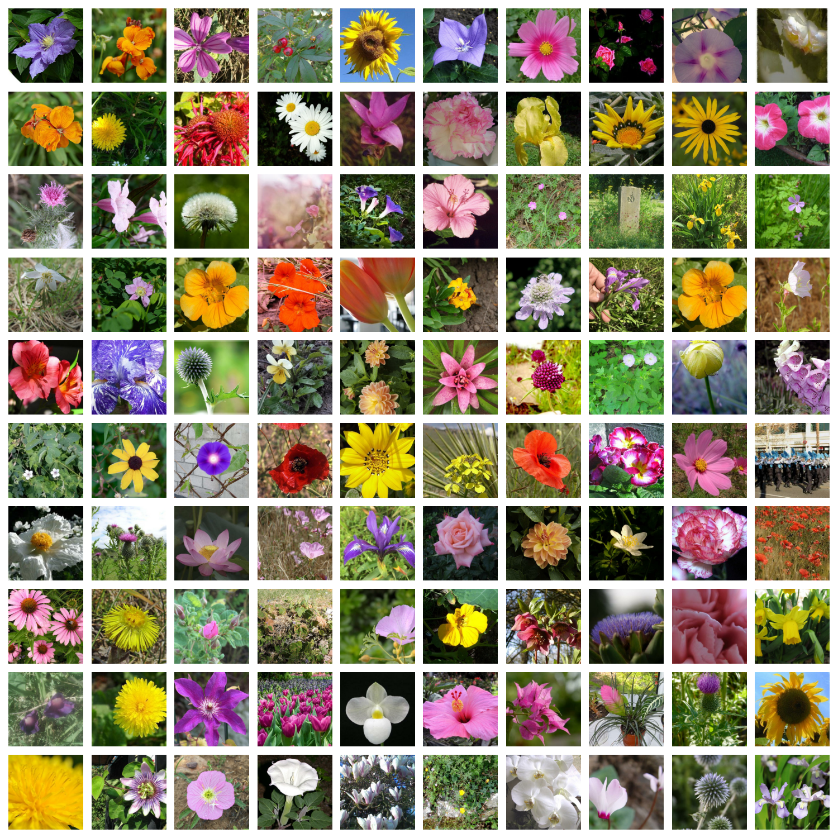
Petals to the Metal Flower Classification
Kaggle challenge
104 classes
Pictures of varying quality
Static data
12753 pictures
224 x 224 px
Notes:
Data contains 104 different classes
Some classes only contain 1 subspecies
Other classes contain multiple subspecies of a larger category
Data might contain misclassified pictures (the teacup)
Data does not change over time (i.e. no need for dvc although we did use it)

Slide 3
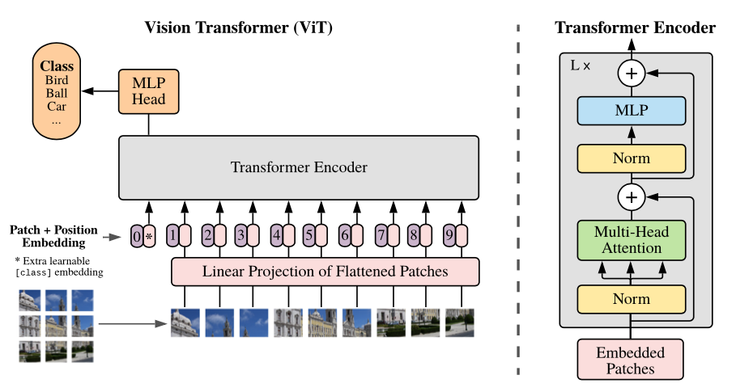
Kornia – Vision Transformer (ViT)
Notes:
Vision transformer with a scalable number of encoders and classifications heads.

